Slide 1
Signal Processing Approach for Triangle Mesh Smoothing
Shaoyu Chen

Slide 2
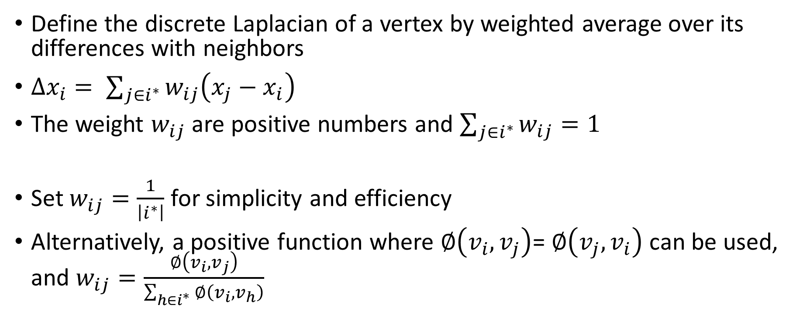
Laplacian Smoothing
Define the discrete Laplacian of a vertex by weighted average over its differences with neighbors
$∆x_{i}= \sum_{j∈i^{∗}}{w_{ij}\left(x_{j}−x_{i}\right)}$
The weight $w_{ij}$ are positive numbers and $\sum_{j∈i^{∗}}{w_{ij}=1}$
Set $w_{ij}=\frac{1}{\left|i^{∗}\right|}$ for simplicity and efficiency
Alternatively, a positive function where $∅\left(v_{i},v_{j}\right)$= $∅\left(v_{j},v_{i}\right)$ can be used, and $w_{ij}=\frac{∅\left(v_{i},v_{j}\right)}{\sum_{h∈i^{∗}}{∅\left(v_{i},v_{h}\right)}}$
Notes:
Let’s start with Laplacian smoothing, which is used in Lab and HW6
i star – set of first order neighbors
the inverse of the number of neighbors
One example of such function is the inverse of distance between the two points, so that the closer a neighbor is, the larger weight it will have

Slide 3
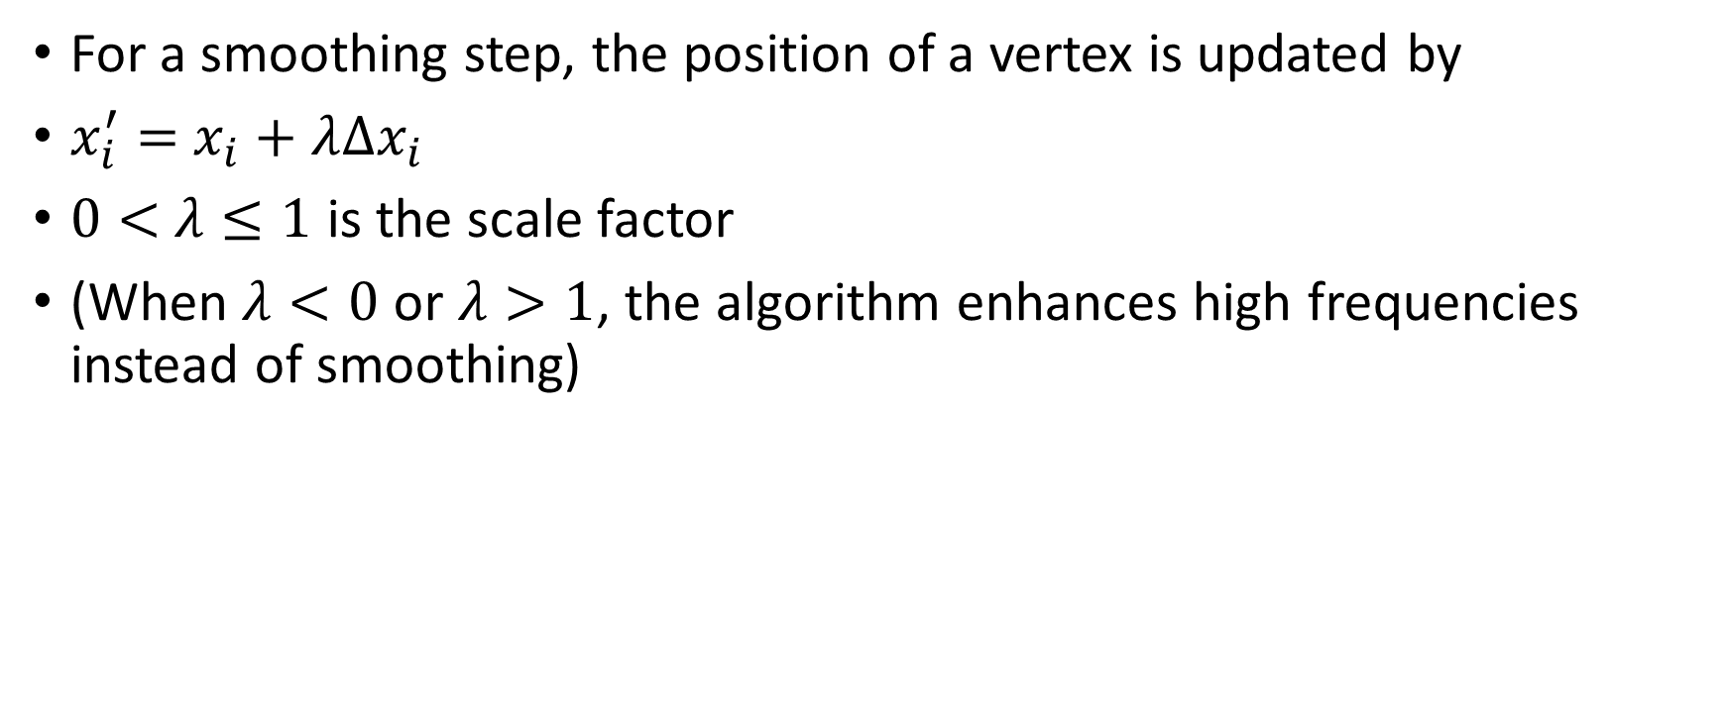
Laplacian Smoothing
For a smoothing step, the position of a vertex is updated by
$x_{i}^{′}=$ $x_{i}+λ∆x_{i}$
$0<$ $λ≤1$ is the scale factor
(When $λ<0$ or $λ>1$, the algorithm enhances high frequencies instead of smoothing)
Notes:
Now let’s look at how to perform the smoothing
We can iterate this step for multiple times to obtain better results
When lambda equals to 1,it becomes the equation that we used in Lab and HW6, Since

Slide 4
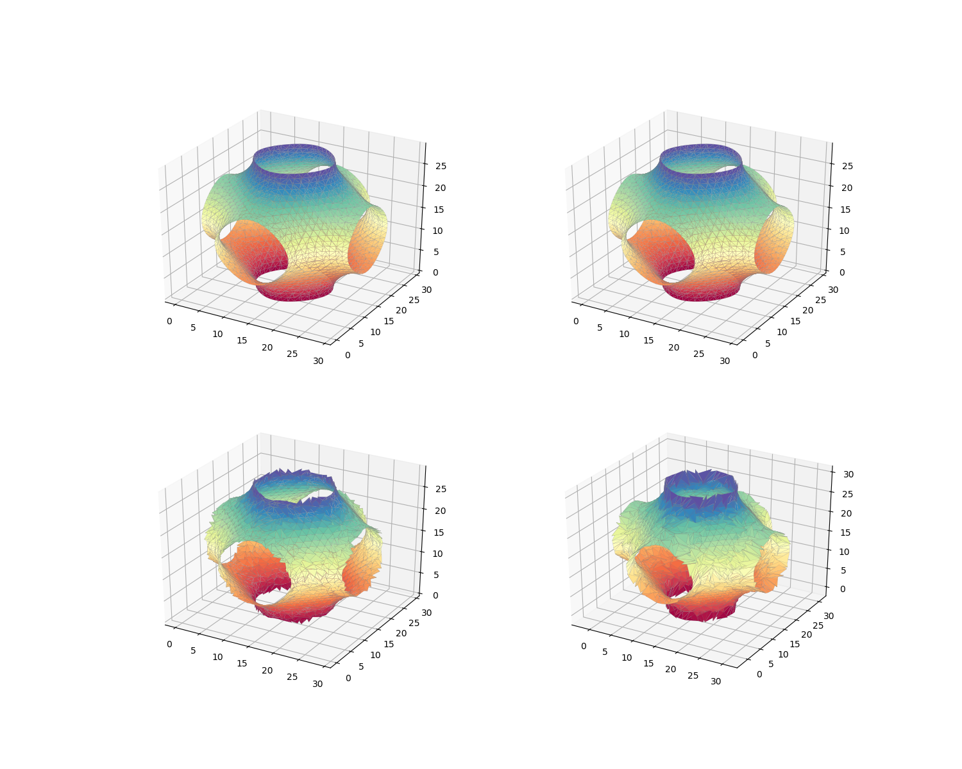


Original
Original
$$λ=2$$
$$λ=−1$$
Notes:
2 iter Bottom-left: lambda=2 Bottom-right: lambda=-1
This shows the effect when lambda is smaller than 0 or larger than 1

Slide 5
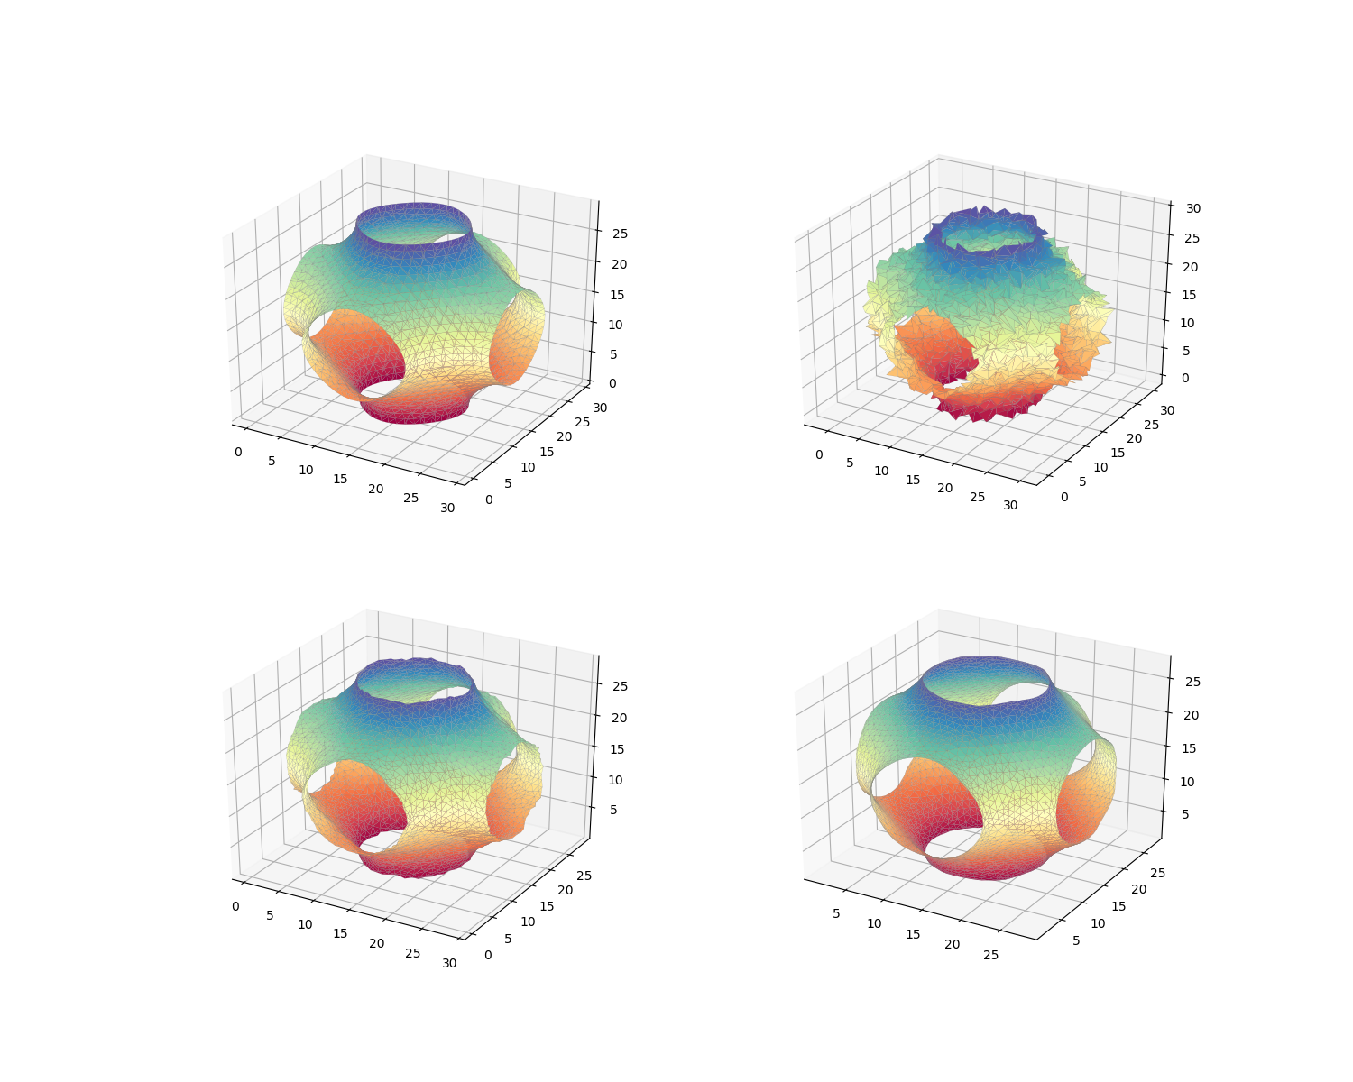
Original
Corrupted
Iters = 2
Iters = 10
Notes:
Lambda=1 bottom-left: 2 iters bottom-right: 10 iters
Normal noise
This image shows the effect of smoothing when lambda equals to 1
… shows the result after 2 iterations, as you can see, it is much smoother
… shows the result after 10 iterations. The result looks quite smooth at the first look. However, you can notice that the holes are much larger than the original one, and the surface is not as curved as the original

Slide 6
Problem
Laplacian Smoothing produces shrinkage
It is not a low-pass filter
Notes:
From this example we can see the Laplacian smoothing has some problems

Slide 7
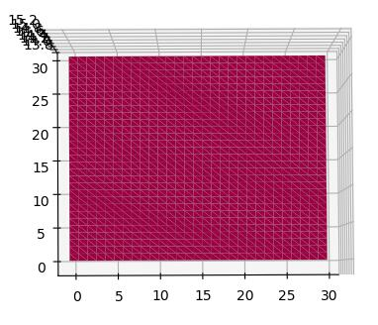
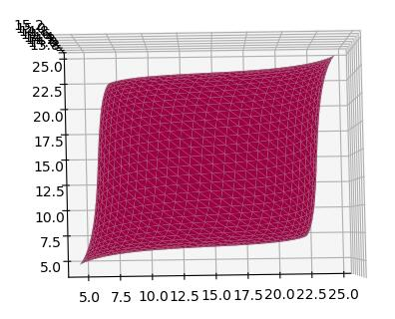
Original
After 100 iterations
Notes:
100iters
This is a case where the problem is very severe – a square face
After 100 iterations, its shape changes a lot
Also, look at the bottomleft point, the coordinate changes from original point to about (5,5) which means that it is much smaller than original

Slide 8
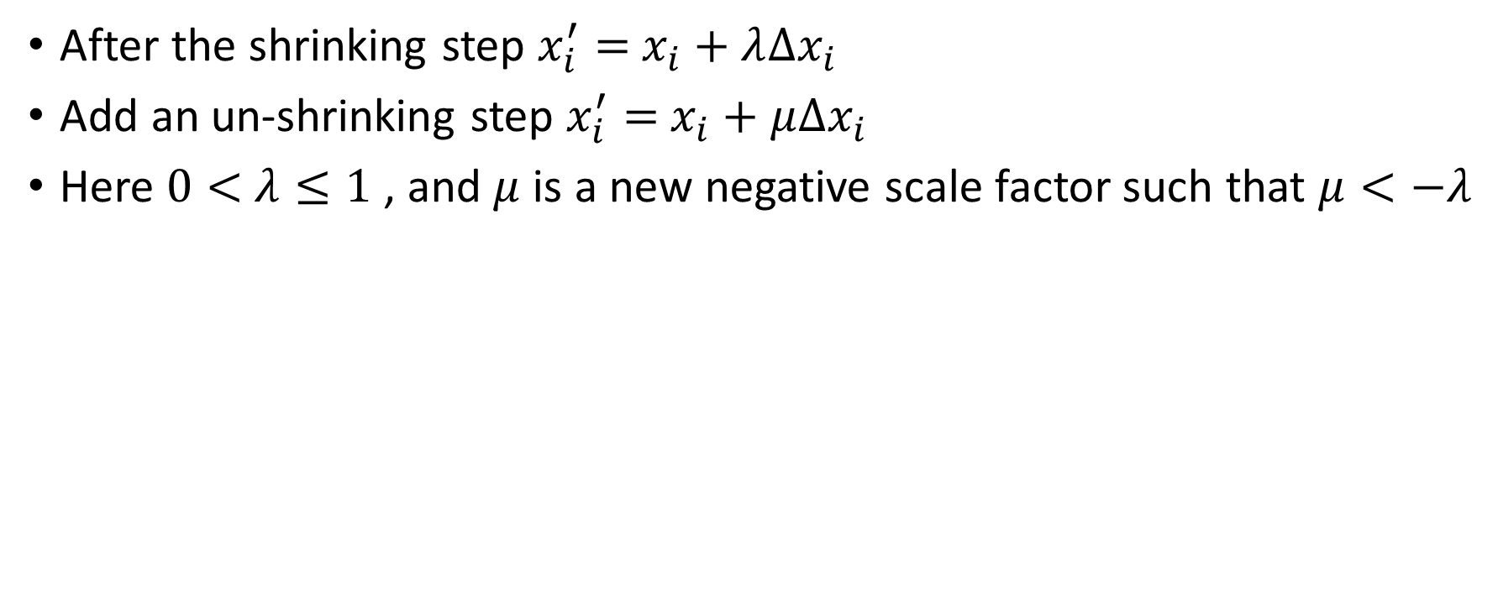
Solution
After the shrinking step $x_{i}^{′}=$ $x_{i}+λ∆x_{i}$
Add an un-shrinking step $x_{i}^{′}=$ $x_{i}+μ∆x_{i}$
Here $0<$ $λ≤1$ , and $μ$ is a new negative scale factor such that $μ<−λ$
Notes:
How can we solve this problem?
The un-shrinking step can compensate the shrinkage and make the algorithm becomes a low-pass filter. That’s why

Slide 9
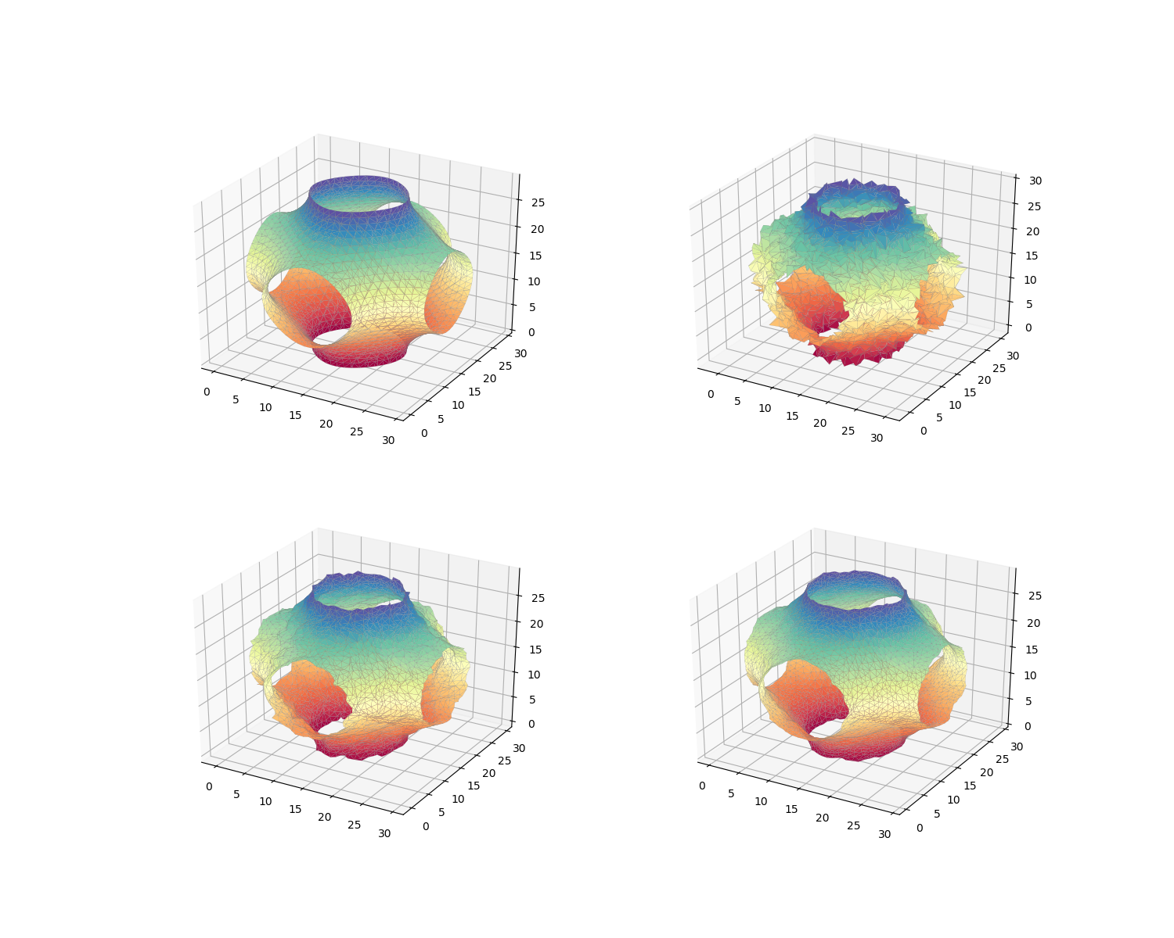
Original
Corrupted
Signal Processing Approach
Iters = 2
Laplacian Smoothing
Iters = 2
Notes:
Iter 2
This is the previous example, …
These are the results obtained after 2 iterations
Both methods make the surface smoother
The un-shrinking stage slows down the smoothing

Slide 10
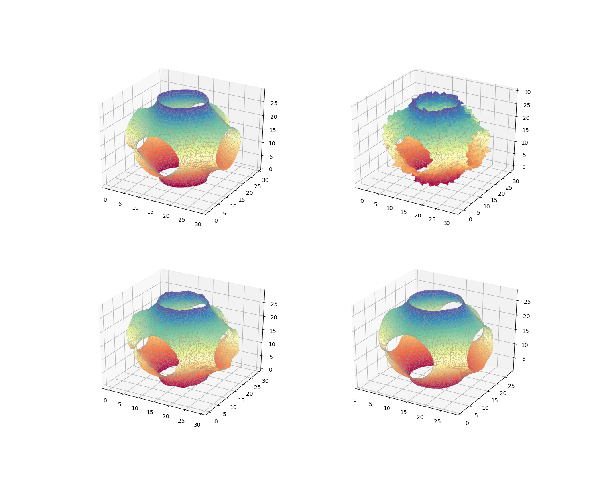
Original
Corrupted
Signal Processing Approach
Iters = 10
Laplacian Smoothing
Iters = 10
Notes:
Iter 10
After 10 iterations, both results are better
We can see the shrinkage

Slide 11
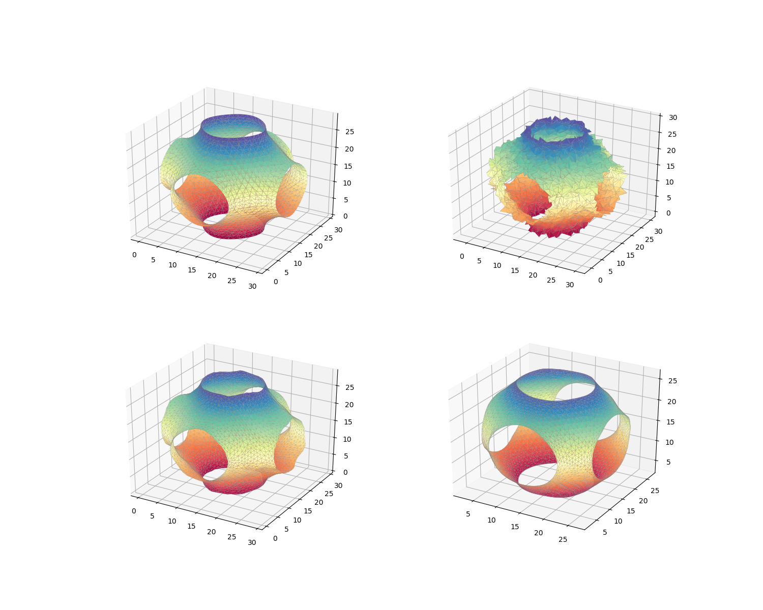
Original
Corrupted
Signal Processing Approach
Iters = 50
Laplacian Smoothing
Iters = 50
Notes:
Iter 50
After 50 iterations,
There is a slight improvement
Suffer from shrinkage and over-smoothing

Slide 12
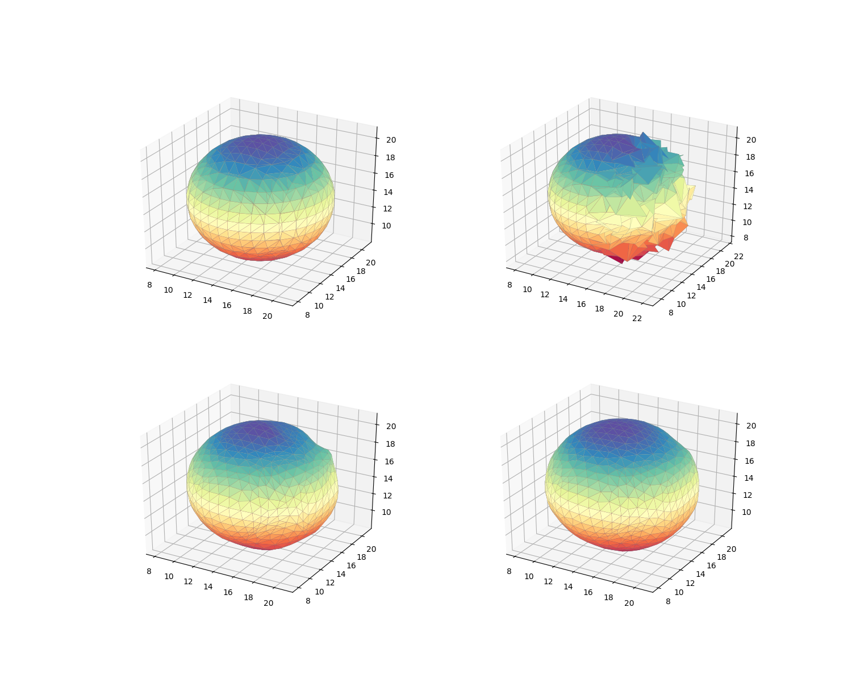
Original
Corrupted
Iters = 10
Iters = 50
Notes:
bottom-left: 10 iters bottom-right: 50 iters
Here is another example, half of the sphere is corrupted by normal noise
Half of it after smoothed while another half are almost unaffected

Slide 13
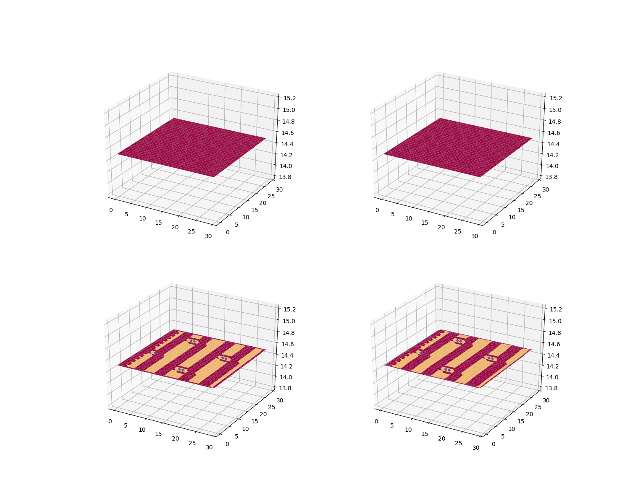
Original
Original
Iters = 10
Iters = 100
Notes:
Lam=0.5 bottom-left: 10 iters bottom-right: 100 iters
For the square face, there is almost no change in terms of shape and total area

Slide 14
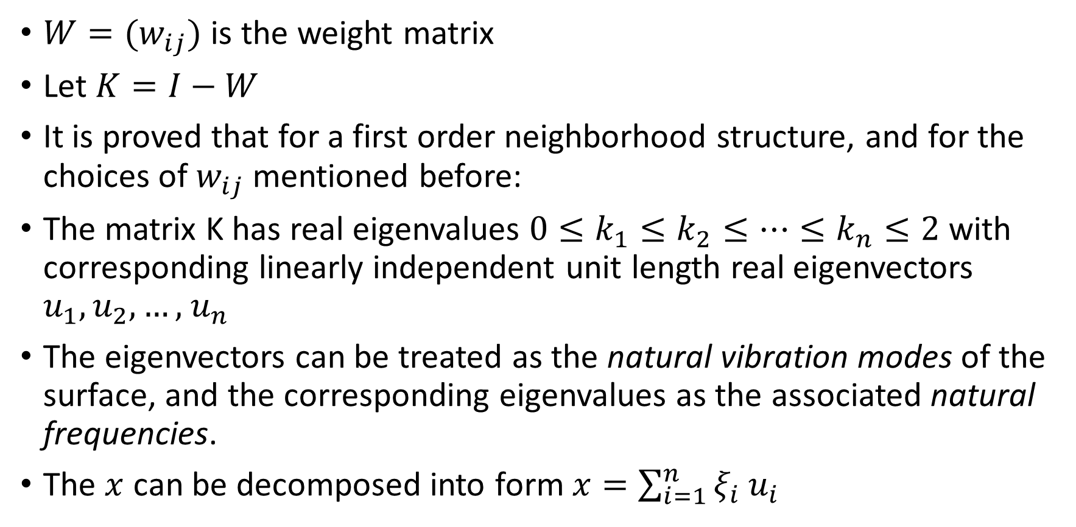
Why this can work
${W=(w}_{ij})$ is the weight matrix
Let $K=I−W$
It is proved that for a first order neighborhood structure, and for the choices of $w_{ij}$ mentioned before:
The matrix K has real eigenvalues $0≤k_{1}≤k_{2}≤…≤k_{n}≤2$ with corresponding linearly independent unit length real eigenvectors $u_{1},u_{2},…,$ $u_{n}$
The eigenvectors can be treated as the natural vibration modes of the surface, and the corresponding eigenvalues as the associated natural frequencies.
The $x$ can be decomposed into form$x=\sum_{i=1}^{n}{ξ_{i}}$ $u_{i}$

Slide 15
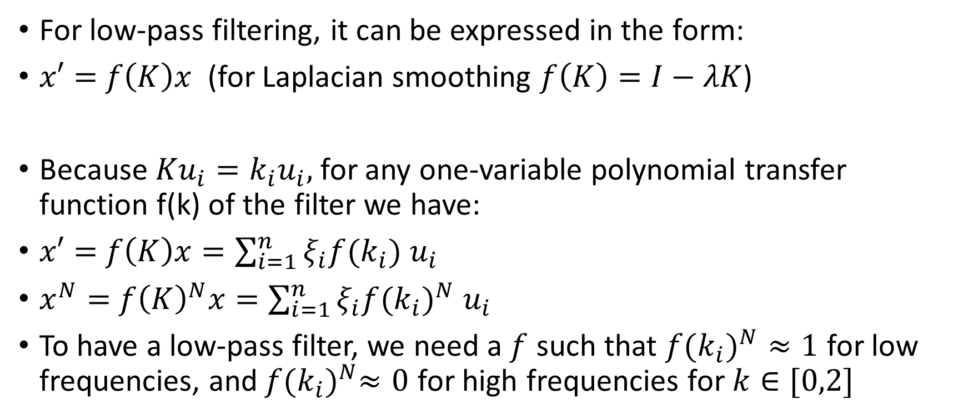
Why this can work
For low-pass filtering, it can be expressed in the form:
$x′=$ $f\left(K\right)x$ (for Laplacian smoothing $f\left(K\right)=I−λK$)
Because ${Ku}_{i}={k_{i}u}_{i},$for any one-variable polynomial transfer function f(k) of the filter we have:
$x′=$ $f\left(K\right)x=\sum_{i=1}^{n}{ξ_{i}f(k_{i})}$ $u_{i}$
$x^{N}=$ ${f\left(K\right)}^{N}x=\sum_{i=1}^{n}{ξ_{i}{f(k_{i})}^{N}}$ $u_{i}$
To have a low-pass filter, we need a $f$ such that ${f(k_{i})}^{N}≈1$ for low frequencies, and${ f(k_{i})}^{N}≈0$ for high frequencies for $k∈[0,2]$

Slide 16
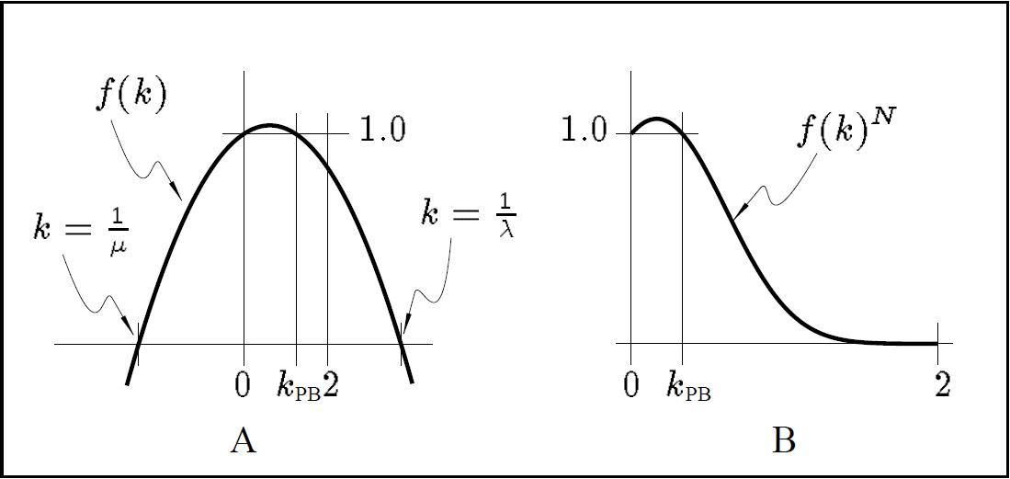
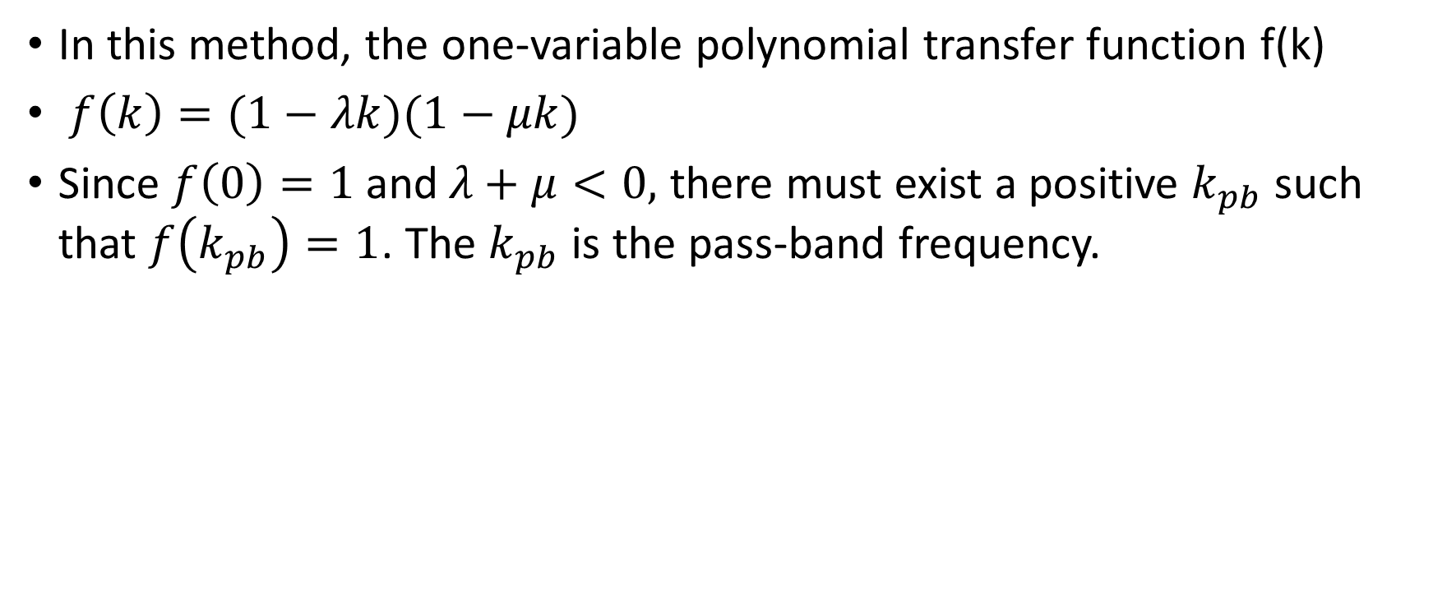
Why this can work
In this method, the one-variable polynomial transfer function f(k)
$f\left(k\right)=(1−λk)(1−μk)$
Since $f\left(0\right)=1$ and$λ+μ<0,$ there must exist a positive $k_{pb}$ such that $f\left(k_{pb}\right)=1$. The $k_{pb}$ is the pass-band frequency.

